Slide 1



PROJECT REPORT
Supermarket Selles Transction Data Mining and Data Analysis Using Association Rule
Reporter:Eyasu Taye, Kalkidan Tesfaye, Chala Bahiru, Bilisie Melese
Department:Computer Science

Slide 2
CONTENTS:
Part Ⅰ: Introduction
Part Ⅲ : Objective
Part Ⅱ : Motivation
Part Ⅳ : Methodology
Part V : Methodology

Slide 3
Part Ⅰ
Introduction

Slide 4

Introduction
Supermarket data, Association rule mining, Frequent items
Supermarkets have large number of customers checking into the items and to know customers need its better to identify which products bought frequently, which products are bought together,and association between items.
Association rule mining is one of the principal problems treated in KDD and can be defined as extracting the interesting correlation and relation among huge number of transactions.
Frequent itemset is generally adopted to generate association rules. As the amount of data stored supermarket database grows twice as fast as the speed of the fastest processor available to analyse it. Main purpose of analysing frequent itemset is to find the association relationship among the large number of database items. It is used to describe the patterns of customers' purchase in the supermarket.

Slide 5
Part Ⅱ
Motivation and Description

Slide 6
Motivation
Our motivation behined mining the supermarket data?
Finding inherent regularities in data is the motivation behind this supermarket data analysis project. Association rule mining is one of the technique to identify underlying relations between different items, it helps to identify which items of supermarket mostly bought together and their correlations.

Slide 7
For instance, if item A and B are bought together more frequently then several steps can be taken to increase the profit.
1.Do no go far away
3.Collective Discount
A and B can be placed together so that when a customer buys one of the product he/she doesn't have to go far away to buy the other product.
Collective discounts can be offered on those products, if the customer buys both.
2.Adverisement Campaign.
4. What to buy together
People who buy one of the products can be targeted through an advertisement campaign to buy the other one.
Both A and B can be packaged together.

Slide 8
Part Ⅲ
Objective

Slide 9
Objective
What do we want to achieve?
The objective of analysing supermarket transaction data is for identification of items that frequently occurred togehter in the traniction found in the databases so that the out come will increase effectiveness in supermarket sell.

Slide 10
Part Ⅳ
Methodology

Slide 11
Methodology
Data Preprocessing
Step 1
Step 2
Step 3
The dataset has the following limitations
Incomplete and Null values
No header row is necessary
Unused column
Data Cleaning
Data Reduction
Data Trnsformation
Make complete the data by inserting default value for null values.
Remove header option from the dataset since it is not necessary so the first row of the dataset can not be treated as header.
Remove unused column from the dataset.
Transform the csv dataset to list data type.

Slide 12

Methodology
So the data is become understandable by the machine to be processed.
That is
Each row corresponds to a transaction and,
Each column corresponds to an item purchased in that specific transaction.

Slide 13
Detail On Data Preprocessing
The dataset dimension
7500 rows
27 columns

Slide 14
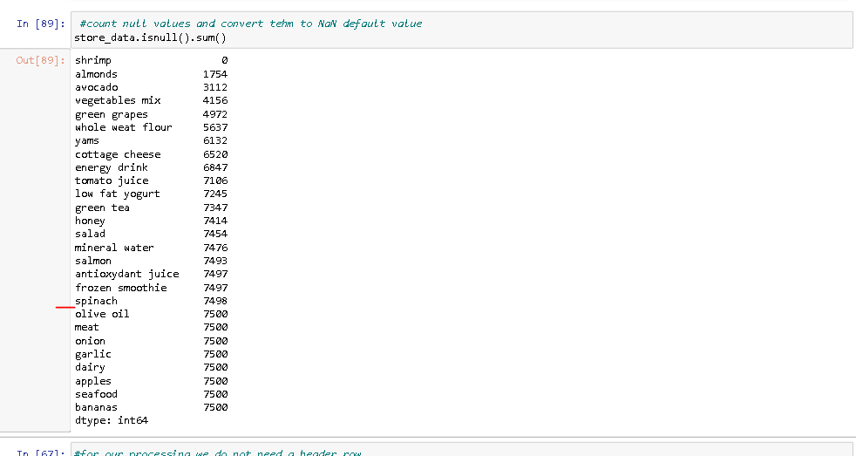
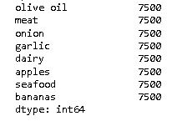
Detail On Data Preprocessing
Columns which are no more important in the dataset
Are not important for our objectives
Must be removed.

Slide 15
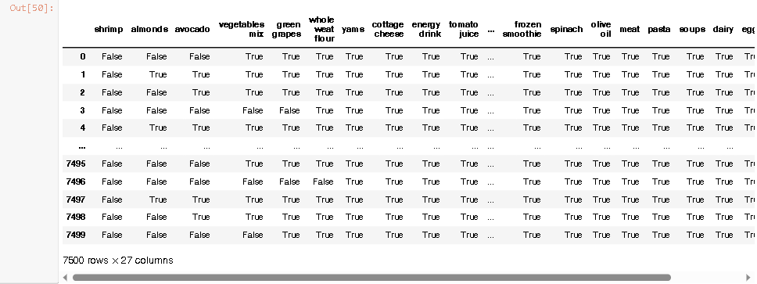
Detail On Data Preprocessing
The first row as a header
The first row is treated as a header, must be transformed to normal row
True = The value is null
False = The value is not null

Slide 16
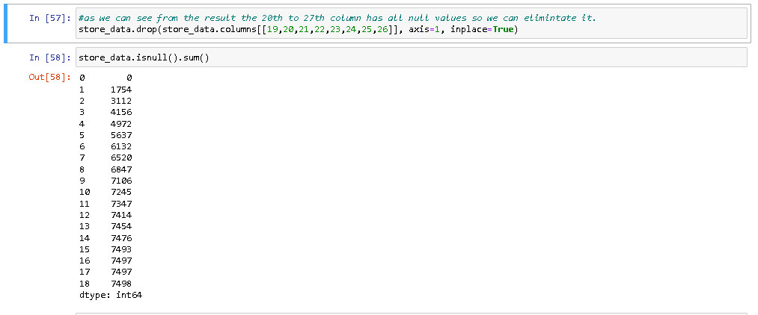
Detail On Data Preprocessing
Data reduction by removing irrelevant columns
8 Columns are
Removed

Slide 17
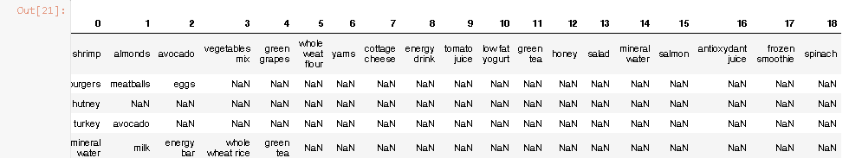
Detail On Data Preprocessing
A header row is removed
Null is transformed to NaN value
A header row is removed
Null is transformed to NaN value
* Now the dataset is clean enough

Slide 18
Data Analysis
The apriori class requires some parameter values to work.
The first parameter must be list of list that to extract rules from.
The second parameter is the min_support parameter.
The min_confidence parameter.
he min_lift parameter specifies the minimum lift value for the short listed rules.
Finally, the min_length parameter specifies the minimum number of items that you want in your rules.
We want to create rules for items purchased five times a day in one week
That means
7*5 = 35 times per week,
So the support = 35/7500 = 0.0045
Let
Minimum confidence = 20% or 0.2
Lift = 3
Min length = 2
by this parameters
48 rules are dicovered

Slide 19
Part V
Evaluation

Slide 20

Evalution
First Rule
The support value is 0.0045. This number is calculated by dividing the number of transactions containing light cream divided by total number of transactions.
.The support value is 0.0045. This number is calculated by dividing the number of transactions containing light cream divided by total number of transactions.
The confidence level for the rule is 0.2905 which shows that out of all the transactions that contain light cream, 29.05% of the transactions also contain chicken.
The lift of 4.84 tells us that chicken is 4.84 times more likely to be bought by the customers who buy light cream compared to the default likelihood of the sale of chicken.

Slide 21

Evalution
Second Rule
The second rule states that mushroom cream sauce and escalope are bought frequently
The support for mushroom cream sauce is 0.0057.
The confidence for this rule is 0.3006 which means that out of all the transactions containing mushroom, 30.06% of the transactions are likely to contain escalope as well.
Lift of 3.79 shows that the escalope is 3.79 more likely to be bought by the customers that buy mushroom cream sauce, compared to its default sale.

Slide 22

Conclusion
Association rule mining for supermarket dataset has been presented, Mining has been applied to sales data of dataset. In proposed project, the apriori algorithm has been used on super market dataset which gives associations of two products which has maximum support, It reduces the size of the itemsets in the database considerably providing a good performance. Thus, data mining helps consumers and industries better in the decision-making process.

Slide 23
Thank you for watching
Click here to add the text, the text is the extraction of your thought, in order to finally present the good effect of the release, please try to be concise and concise; if necessary, add or subtract the text.
Reporter:XXXX
Department:XXXXX

